Slide 1
Project 5
——design-review
2020/12/21

Slide 2
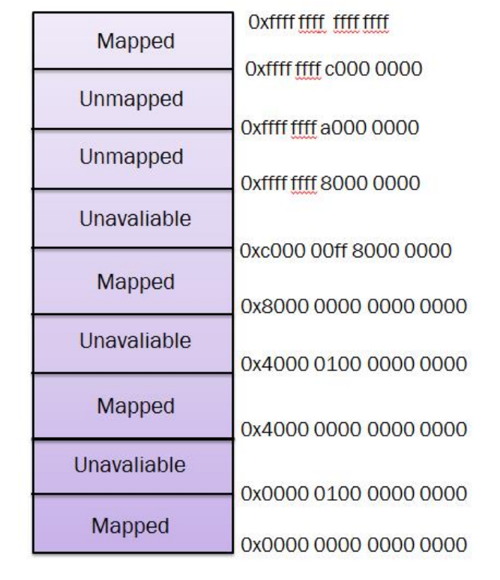
Q1: memory addresses of TX/RX descriptors
// starting address of DMA recv description
#define DMA_RX_ADDR (0xffffffffa1000000)
// starting address of DMA send description
#define DMA_TX_ADDR (0xffffffffa1004000)
#define DMA_DES_SIZE 0x100 // 32*8 bits for each DES
#define DMA_DES_RANG 0x8000 // malloced space
#define RDS_NUM 64
#define TDS_NUM 64
uint64_t recv_flag[PNUM] = {0};
uint64_t send_flag[PNUM] = {0};
It will not conflict will stack.

Slide 3
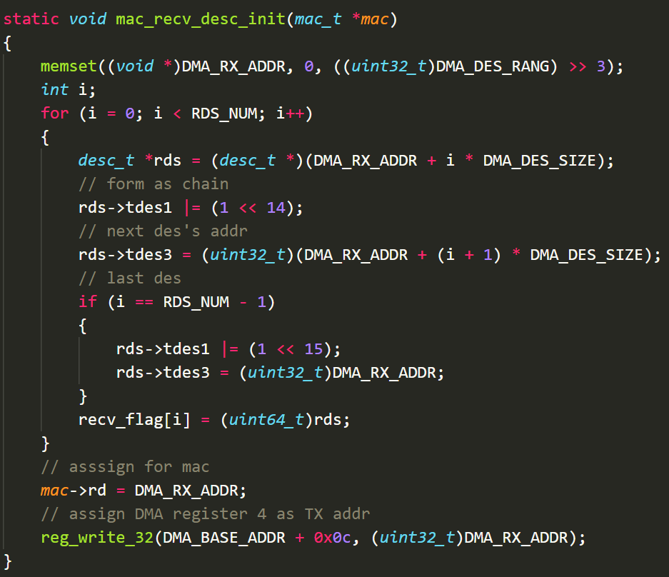
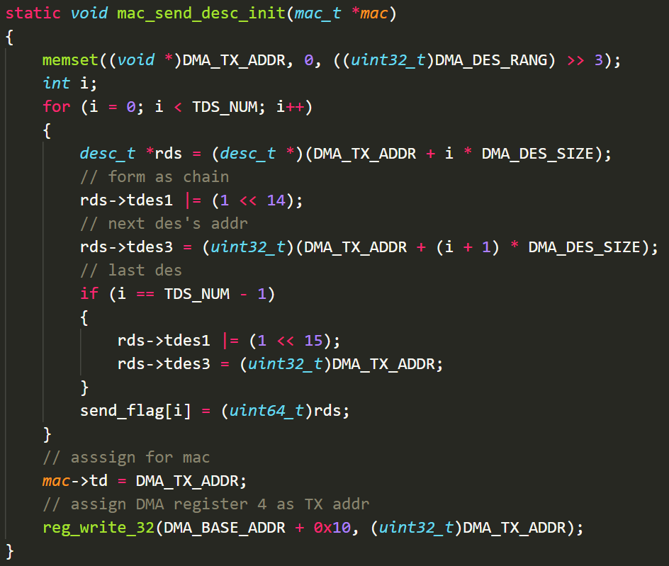
Q1: fill TX/RX descriptors

Slide 4
Q1: registers use to handle DMA process
Type | Index | Function
GMAC | 0 | Enable TX(3) and RX(4)
 | Entry | Handle by core 0
DMA | 1 | Write 0x01 to send
 | 2 | Write 0x01 to recv
 | 3 | Address of RDES
 | 4 | Address of TDES
 | 6 | Start TX/RX
 | 7 | Default
Device | enset, clr, pol, edge... | Interrupt vector

Slide 5
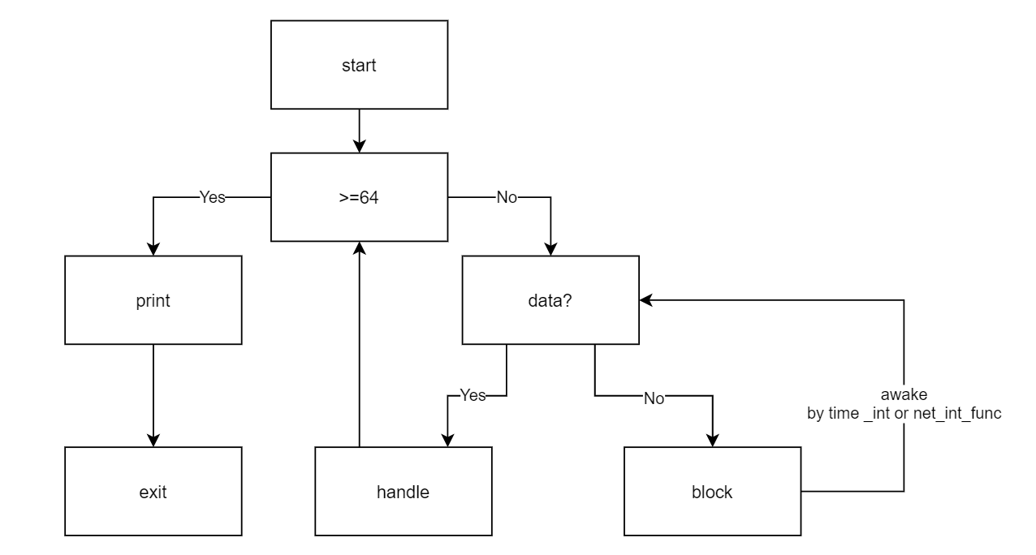
Q2: procedure for receiving data

Slide 6
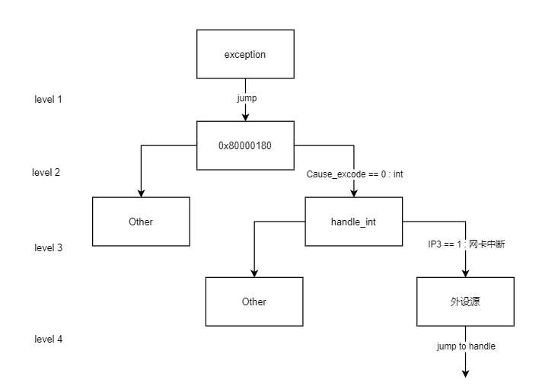
Q3: procedure of interrupt handler

Slide 7
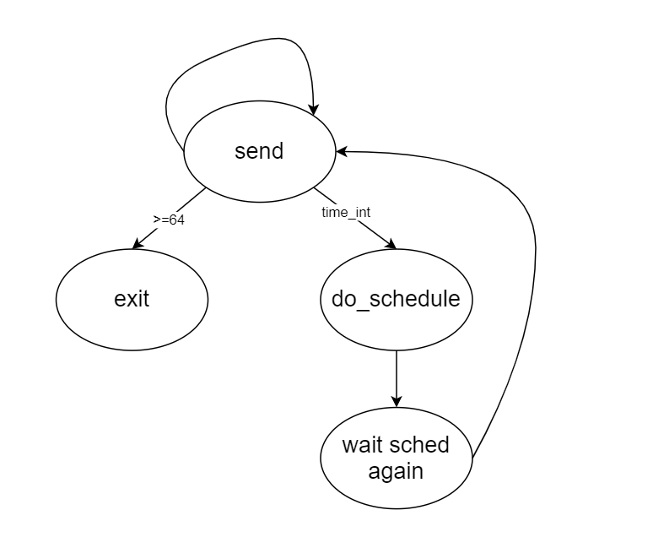
Q4: procedure for transmitting data

Slide 8
Questions
Will the hardware automatically look for the next descriptor?

